Slide 1
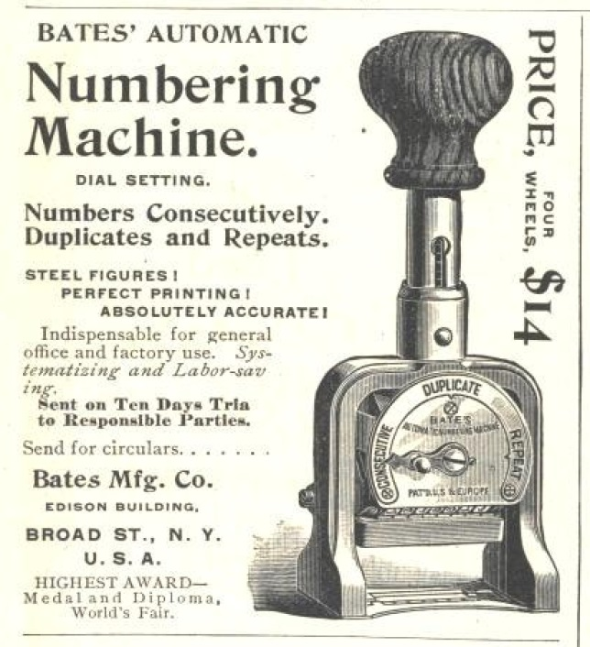
INTRODUCTION TO COMPUTING
NUMBERING
AND
CODING SYSTEMS

Slide 2
OBJECTIVES
Convert any number from base 2, base 10 or base p to any of the other bases
Count in binary and hex (& p-base numbers)
Add and subtract hex numbers
Add binary numbers (& p-base numbers)
Represent any binary number in 2's complement
Represent an alphanumeric string in ASCII code
The difference between a bit, a byte and a word
Definitions of the terms kilo-, mega-, giga- & tera byte

Slide 3

To understand the software & hardware of the computer, one must first master some basic concepts underlying computer design.

Slide 4
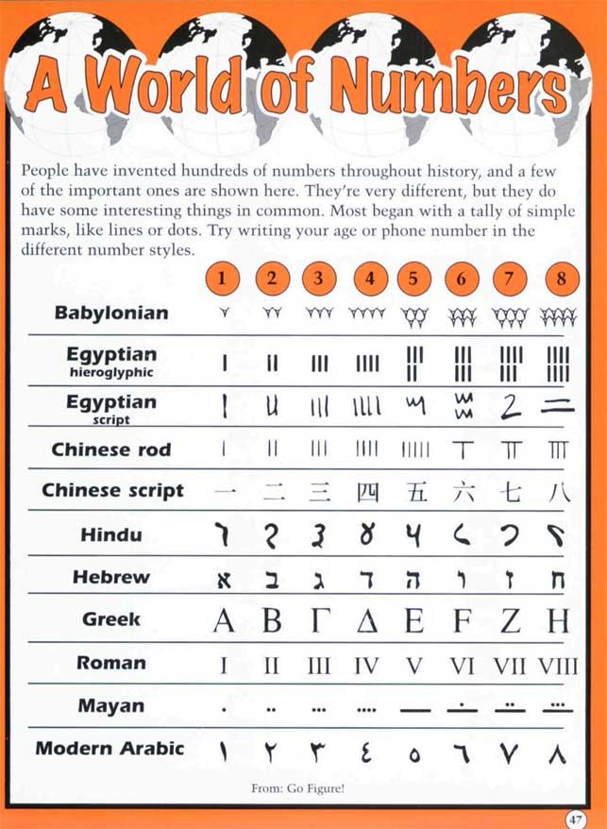
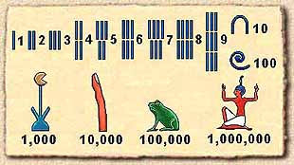

Slide 5

Roman Numerals

Slide 6
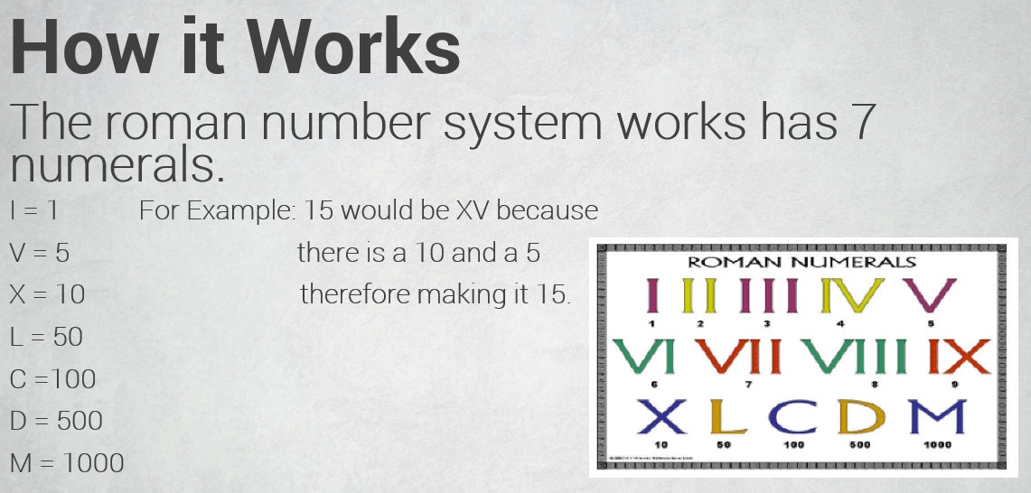
Roman Numerals

Slide 7
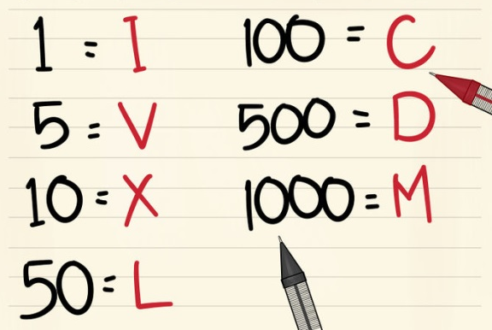
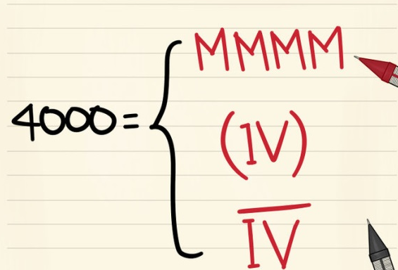
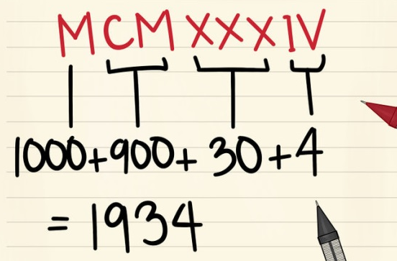
Roman Numerals
MCMXXXIV

Slide 8
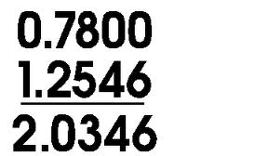
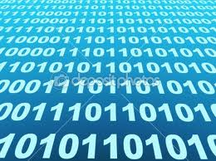
Decimal and binary number systems
The origin of the base 10 system is the fact that human beings have 10 fingers.
The binary system is used in computers because 1 and 0 represent the two voltage levels: on and off.
In base 10 there are 10 distinct symbols: 0,1,2, ... ,9,
in base 2 there are only two: 0 and 1.
These two binary digits are referred to as bits.

Slide 9
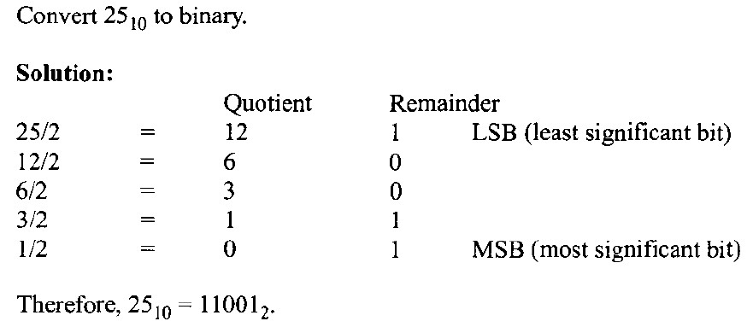
Converting from decimal to binary
One method of converting from decimal to binary is to divide the decimal number by 2 repeatedly, keeping track of the remainders. This process continues until the quotient becomes zero. The remainders are then written in reverse order to obtain the binary number:

Slide 10
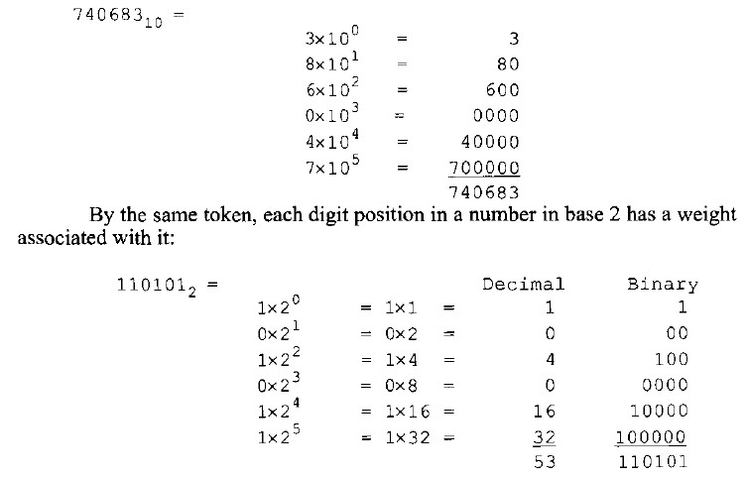
Converting from binary to decimal
To convert from binary to decimal, it is important to understand the concept of weight associated with each digit position. First, as an analogy, recall the weight of numbers in the base 10 system:

Slide 11
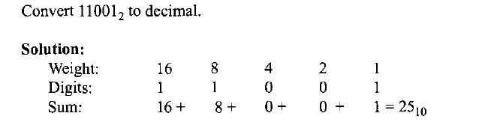
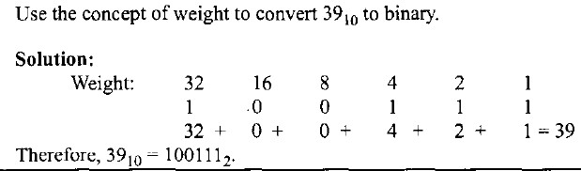

Slide 12
Hexadecimal system
as it is called in computer literature, is used as a convenient representation of binary numbers.
It is much easier for a human being to represent a string of Os and 1s such as 100010010110 as its hexadecimal equivalent of 896H.
The binary system has 2 digits: 0 and 1.
The base 10 system has 10 digits, 0 through 9.
The hexadecimal system (base 16) has 16 digits:
0, 1, 2, 3, 4, 5, 6, 7, 8, 9, A, B, C, D, E, F

Slide 13
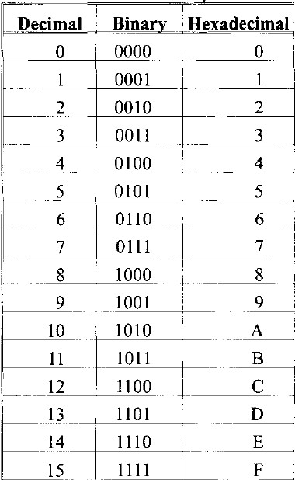
Converting between binary and hex
To represent a binary number as its equivalent hexadecimal number,
start from the right and group 4 bits at
a time, replacing each
4-bit binary number with its hex equivalent shown in Table:

Slide 14
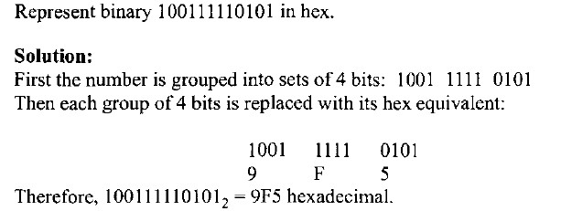
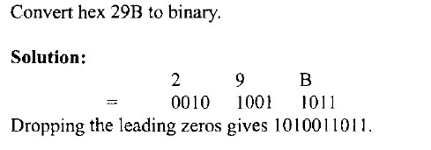

Slide 15

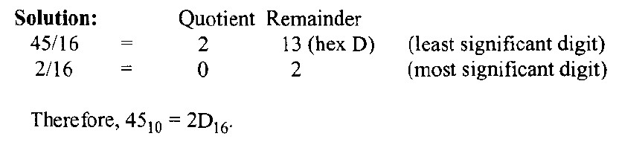
Example 1

Slide 16

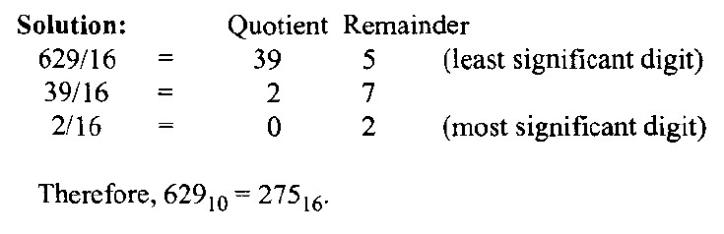
Example 2

Slide 17

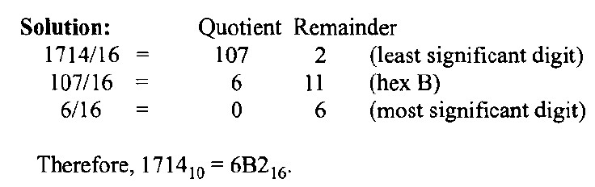
Example 3

Slide 18
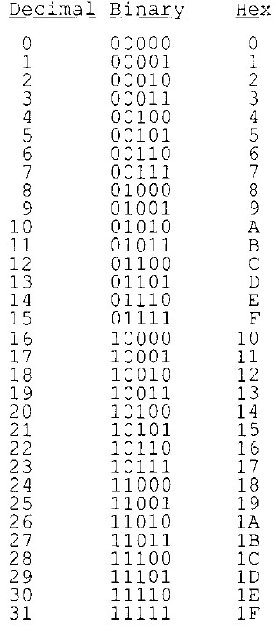
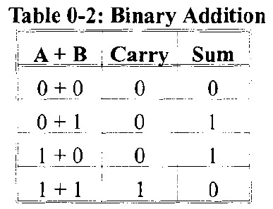
Counting in bases 10, 2, and 16
To show the relationship between all three bases, in Figure we show the sequence of numbers from 0 to 31 in decimal, along with the equivalent binary and hex numbers. Notice in each base that when one more is added to the highest digit, that digit becomes zero and a 1 is carried to the next-highest digit position.
For example, in decimal, 9 + 1 = 0 with a carry to the next-highest position.
In binary, 1 + 1 = 0 with a carry;
in hex, F + 1 = 0 with a carry.
Zrobić tę tab w Excel:
Notes:
Zrobić w excel tabelę

Slide 19
Addition of binary and hex numbers
The addition of binary numbers is
a very straightforward process. Table:
shows the addition of two bits.
The discussion of subtraction of binary numbers is bypassed since all computers use the addition process to implement subtraction.
Although computers have adder circuitry, there is no separate circuitry for subtractors. Instead, adders are used in conjunction with 2 s complement circuitry to perform subtraction. In other words, to implement "x - y",
the computer takes the 2's complement of y and adds it to x.
adder [`ædə(r)] - (el.) sumator; circuitry [`sə:kɪtrɪ] - układ elektryczny
Notes:
straightforward [streɪt`fo:wəd] - prosty, bezpośredni, jasny
circuitry [`sə:kɪtrɪ] - układ elektryczny (zespół układów)
adder [`ædə(r)] - żmija; (el.) sumator

Slide 20
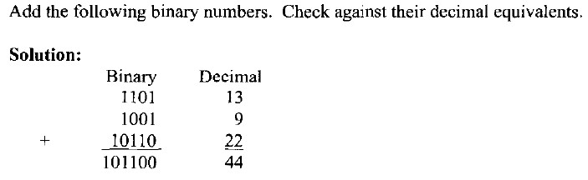
The addition of binary numbers - Example

Slide 21
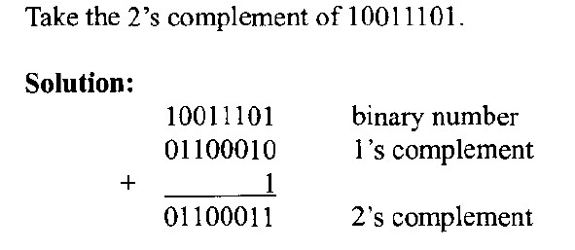
2's complement
To get the 2's complement of a binary number, invert all the bits & then add 1 to the result.
Inverting the bits is simply a matter of changing 0 ←→ 1.
This is called the 1s complement. See Example:
Complement [`komplɪmənt] - uzupełnienie
Notes:
Complement [`komplɪmənt] - uzupełnienie

Slide 22
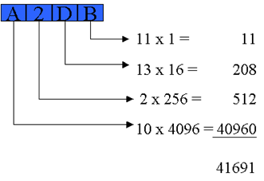
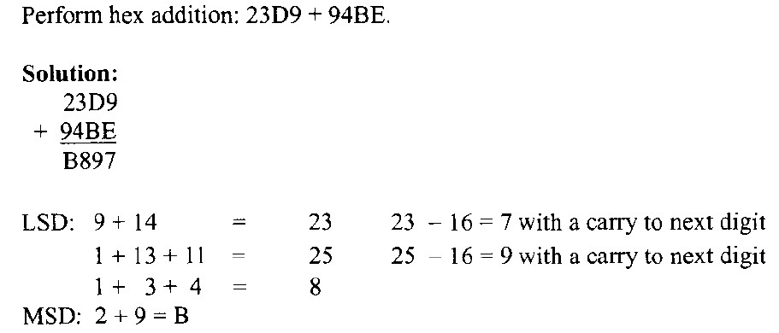
Addition of hex numbers
Description of the process of adding hex numbers: starting with the least significant digits, the digits are added together. If the result is less than 16, write that digit as the sum for that position. If it is greater than 16, subtract 16 from it to get the digit and carry I to the next digit. The example:

Slide 23
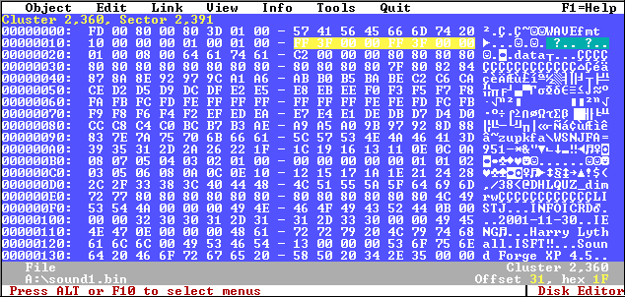
Addition and subtraction of hex numbers
In studying issues related to software and hardware of computers, it is often necessary to add or subtract hex numbers.
Mastery of these techniques is essential.

Slide 24
Binary Numbers: Special Powers of 2
denoted
2¹⁰ (1 024 => 10³ ) is Kilo, „K”
2²⁰ (1 048 576 => 10⁶ ) is Mega, „M”
2³⁰ (1073741824 =>10⁹ ) is Giga, „G”
2⁴⁰ (1099511627776=>10¹²) is Tera, „T”
2⁵⁰ (1125899906842624 => 10¹⁵) is Peta, „P”

Slide 25
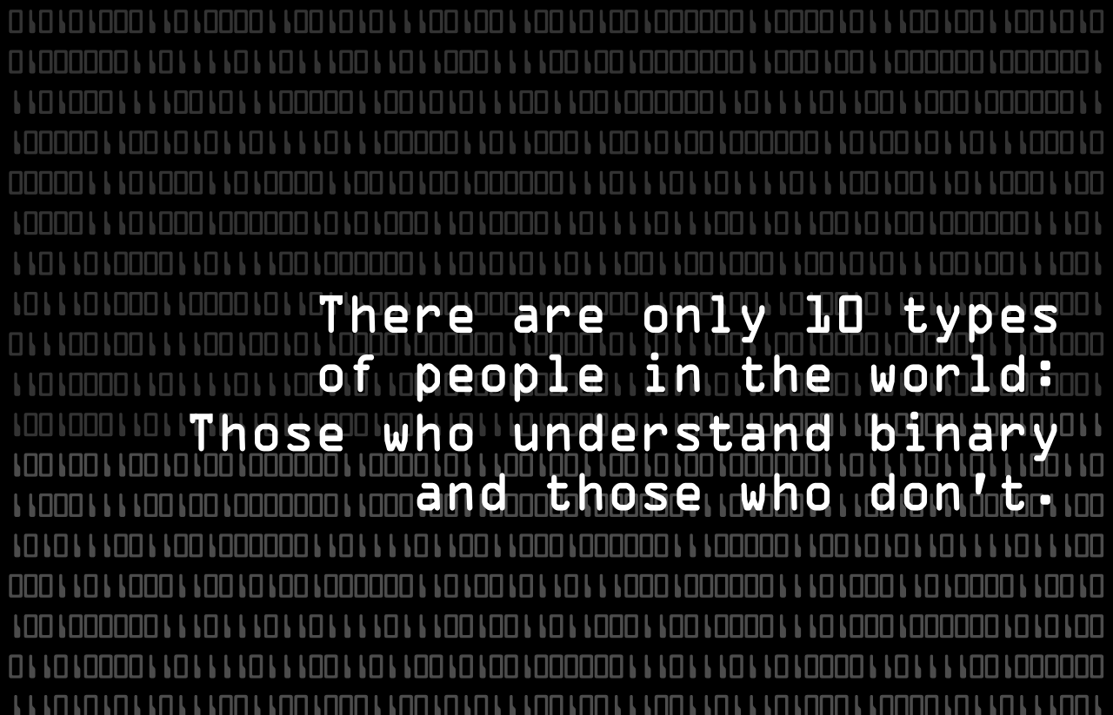

Slide 26
CODING SYSTEMS
ASCII code
ISO 8859

Slide 27
CODING SYSTEMS - ASCII code
The discussion so far has revolved around the representation of number systems. Since all information in the computer must be represented by 0s and 1s, binary patterns must be assigned to letters and other characters.
In the 1960s a standard representation called ASCII was established.
The ASCII code assigns binary patterns for numbers 0 to 9, all the letters of the English alphabet, both uppercase (capital) and lowercase, and many control codes and punctuation marks.
The great advantage of this system is that it is used by most computers, so that information can be shared among computers. The ASCII system uses a total of 7 bits to represent each code. For example, 1000001 is assigned to the uppercase letter "A" and 110 0001 is for the lowercase "a".
ASCII - American Standard Code for Information Interchange

Slide 28
Kod ASCII (7-bitowy)
American Standard Code for Information Interchange
7-bitowy kod przyporządkowujący liczby z zakresu 0-127 literom (alfabetu angielskiego), cyfrom, znakom przestankowym i innym symbolom oraz poleceniom sterującym.
Litery, cyfry oraz inne znaki drukowane tworzą zbiór znaków ASCII.
Jest to 95 znaków o kodach 32-126
Pozostałe 33 kody (0-31 i 127) to tzw. kody sterujące służące do sterowania urządzeniem odbierającym komunikat, np. drukarką czy terminalem
Ponieważ kod ASCII jest 7-bitowy, a większość komputerów operuje na 8-bitowych bajtach, dodatkowy bit można wykorzystać na powiększenie zbioru kodowanych znaków. Powstało wiele różnych rozszerzeń ASCII wykorzystujących ósmy bit nazywanych stronami kodowymi

Slide 29
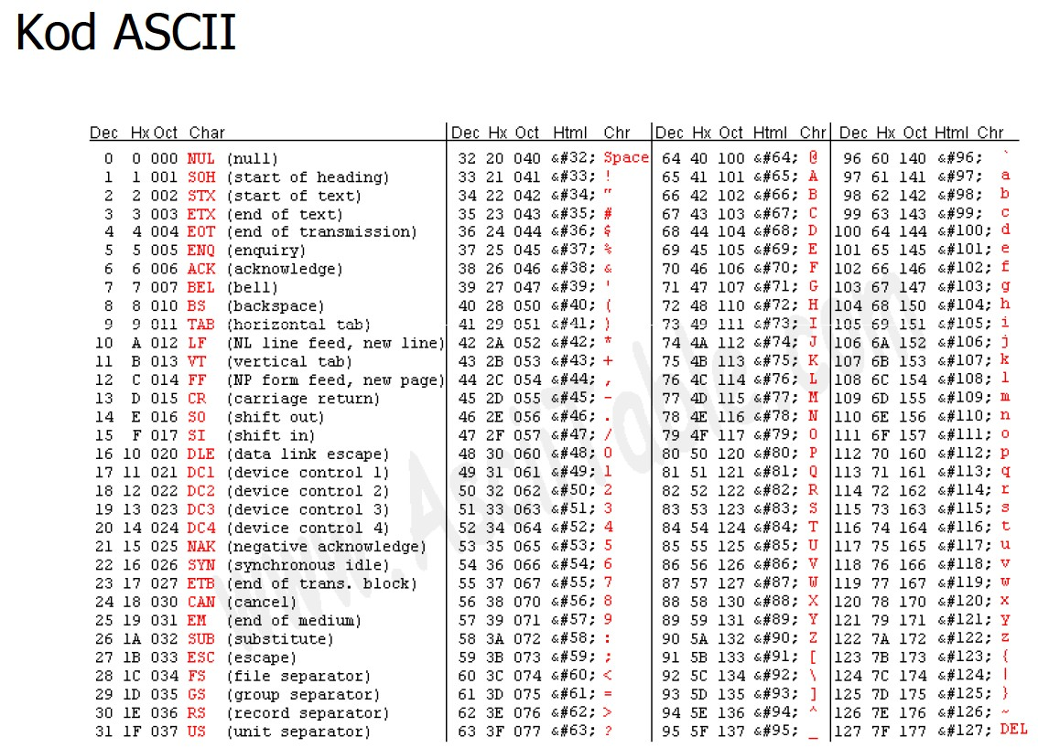
Kod ASCII (7-bitowy)
American Standard Code for Information Interchange
7-bitowy kod przyporządkowujący liczby z zakresu 0-127 literom (alfabetu angielskiego), cyfrom, znakom przestankowym i innym symbolom oraz poleceniom sterującym.
Litery, cyfry oraz inne znaki drukowane tworzą zbiór znaków ASCII.
Jest to 95 znaków o kodach 32-126
Pozostałe 33 kody (0-31 i 127) to tzw. kody sterujące służące do sterowania urządzeniem odbierającym komunikat, np. drukarką czy terminalem
Ponieważ kod ASCII jest 7-bitowy, a większość komputerów operuje na 8-bitowych bajtach, dodatkowy bit można wykorzystać na powiększenie zbioru kodowanych znaków. Powstało wiele różnych rozszerzeń ASCII wykorzystujących ósmy bit nazywanych stronami kodowymi

Slide 30
Kod ISO 8859 (8-bitowy)
ISO/IEC 8859 to zestaw standardów służących do kodowania znaków za pomocą 8 bitów
Wszystkie zestawy ISO 8859 mają znaki 0-127 takie same jak ASCII, zaś pozycjom 128-159 przypisane są dodatkowe kody sterujące, tzw. C1
ISO 8859-1 (Latin-1) - alfabet łaciński dla Europy zachodniej
ISO 8859-2 (Latin-2) - łaciński dla Europy środkowej i wschodniej, również odpowiednia Polska Norma
ISO 8859-3 (Latin-3) - łaciński dla Europy południowej
ISO 8859-4 (Latin-4) - łaciński dla Europy północnej
ISO 8859-5 (Cyrillic) - dla cyrylicy
ISO 8859-6 (Arabic) - dla alfabetu arabskiego
ISO 8859-7 (Greek) - dla alfabetu greckiego
ISO 8859-8 (Hebrew) - dla alfabetu hebrajskiego

Slide 31
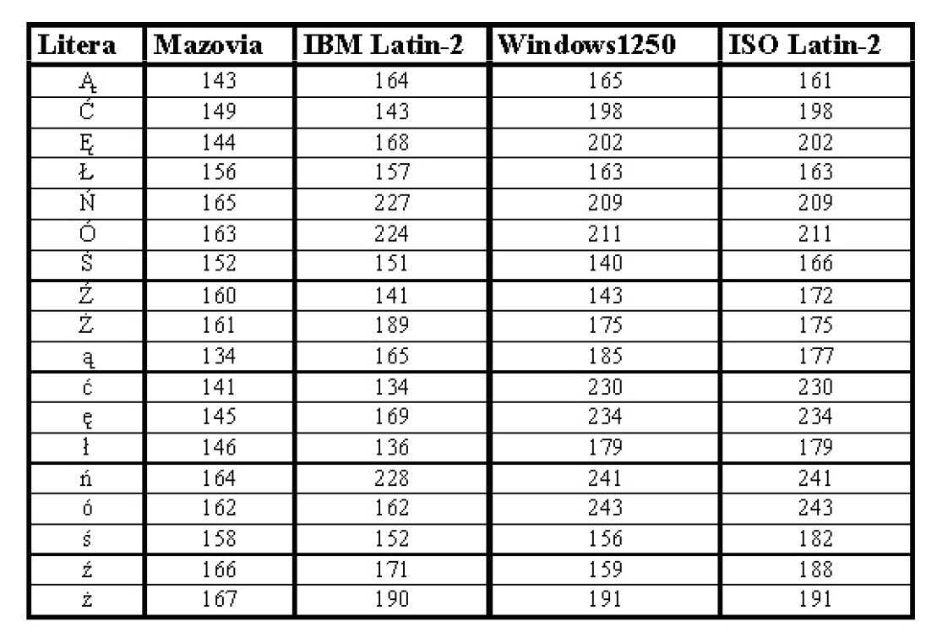
Polskie litery (20 „standardów”)

Slide 32
Review Questions
Why do computers use the binary number system
instead of the decimal system?
2. Convert 34₁₀ to binary and hex.
3. Convert 110101₂ to hex and decimal.
4. Perform binary addition: 101100 + 101.
5. Convert 101100₂ to its 2's complement
representation.
6. Add 36BH + F6H.
7. Subtract 36BH - F6H.
8. Write "80x86 CPUs" in its ASCII code (in hex form).

Slide 33
Some important terminology
One of the most important features of a computer is how much memory it has. Next we review terms used to describe amounts of memory.
A bit is a binary digit that can have the value 0 or 1.
A byte is defined as 8 bits.
A word is two bytes, or 16 bits.
The following display is intended to show the relative size of these units:
Bit 0
Byte 0000 0000
Word 0000 0000 0000 0000

Slide 34
Important terminology
A kilobyte is 2¹⁰ bytes, which is 1024 bytes.
The abbreviation K is often used.
A megabyte is 2²⁰ bytes, That is a little over 1 million
bytes; it is exactly 1,048,576.
A gigabyte is 2³⁰ bytes (over 1 billion), and
A terabyte is 2⁴⁰ bytes (over 1 trillion).
As an example of how some of these terms are used, suppose that a given computer has 16 megabytes of memory.
That would be 16 x 2²⁰, which is 2²⁴
Therefore 16 megabytes is 2²⁴ bytes.

